Slide 1
COVID-19, Long COVID, and other Health Challenges in Latinx Communities (January 22, 2024)
https://latinocenterforhealth.org/
Notes:
Thank Nina Martinez and the latino civic alliance
Mention what an honor it is to be invited to present today – as the son of immigrant parents and someone born, raised and educated here in washington

Slide 2
Speaker
Leo Sergio Morales, MD, PhD, MPH (he/him)
Co-Director, Latino Center for Health
Professor and Assistant Dean, School of Medicine
University of Washington
lsm2010@uw.edu
Disclosures
None
Latino Center for Health
The Latino Center for Health is a state-funded interdisciplinary research center at the University of Washington. Housed administratively by the School of Social Work, the center conducts community-engaged research through capacity building and authentic partnerships with community stakeholders to promote the health and well-being of Latino communities in Washington State.
Notes:
Our mission is to promote the health of Latino communities through community-engaged research.

Slide 3
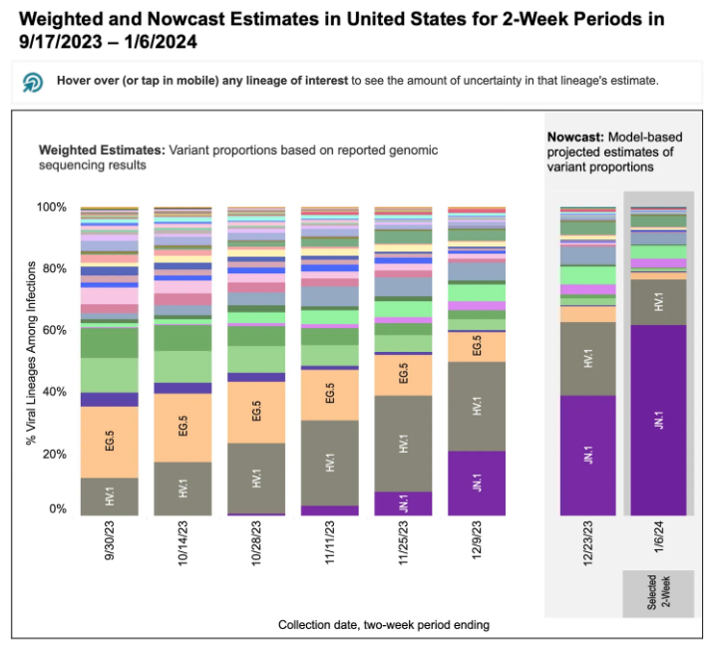
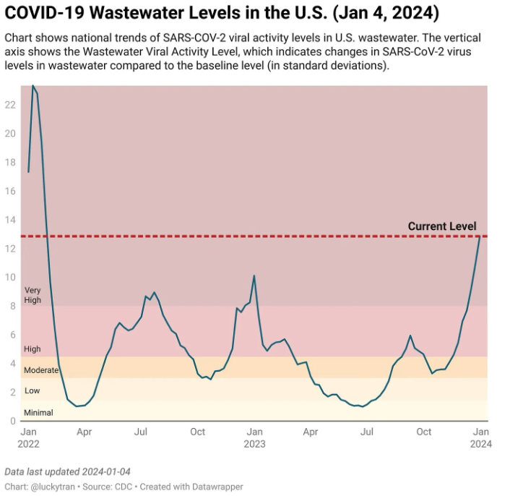
Current Status
Cases
Omicron
Delta
Delta
Alpha
Omicron Variants
Hospitalizations
Source: Topol, E. (2024, January 6). SOTP: State-of-the-Pandemic. Ground Truths. https://substack.com/inbox/post/140396075

Slide 4
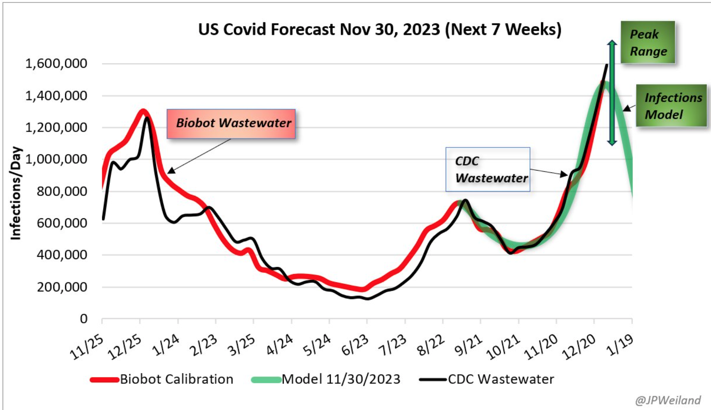
Projected COVID-19 Infections 11/25/2023-1/19/2024
These Number Suggest:
1,480,000 new infections per day
1 in 22 currently infected

Slide 5
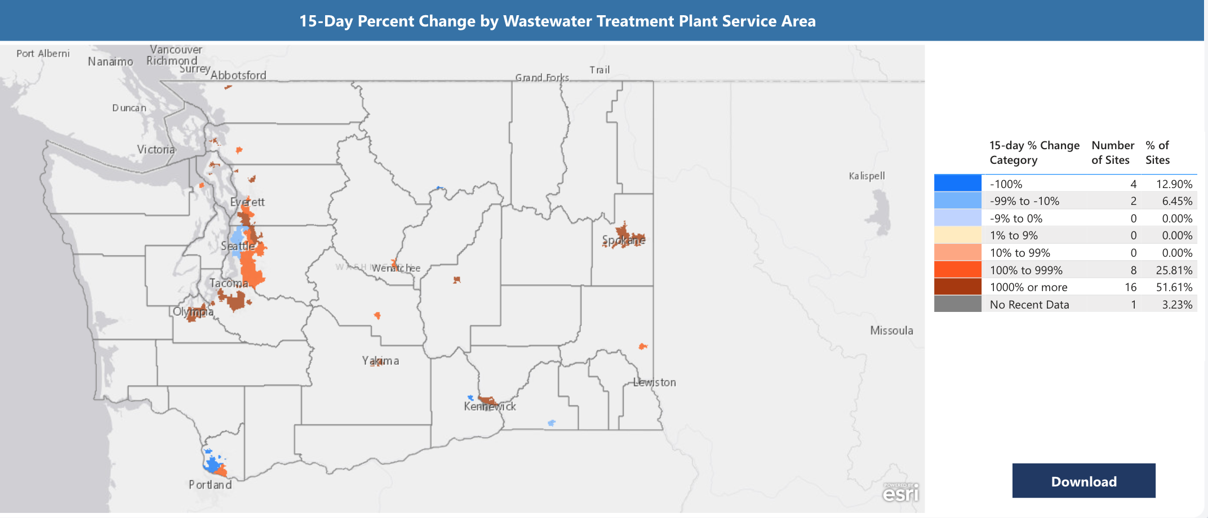
Waste Water Monitoring for WA as of 01.03.2024

Slide 6
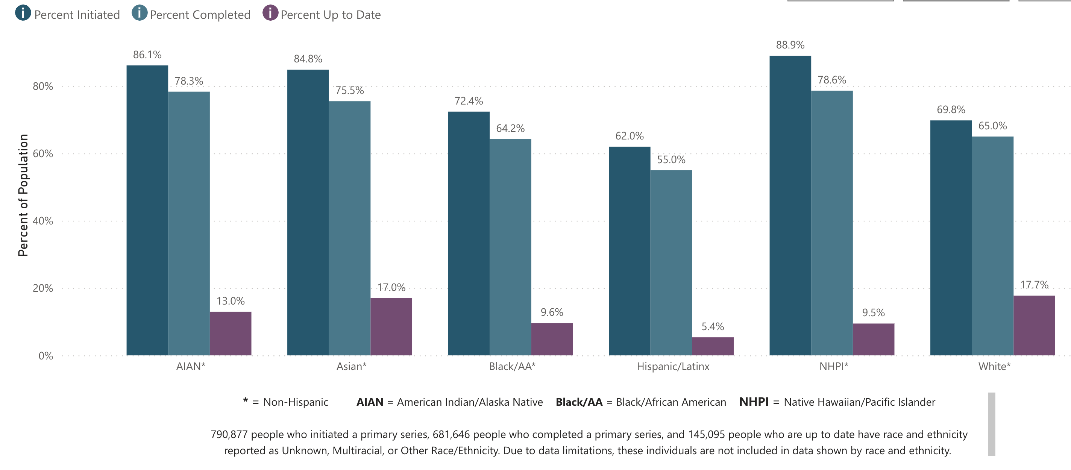
Vaccination Coverage WA as of 01/01/2024

Slide 7
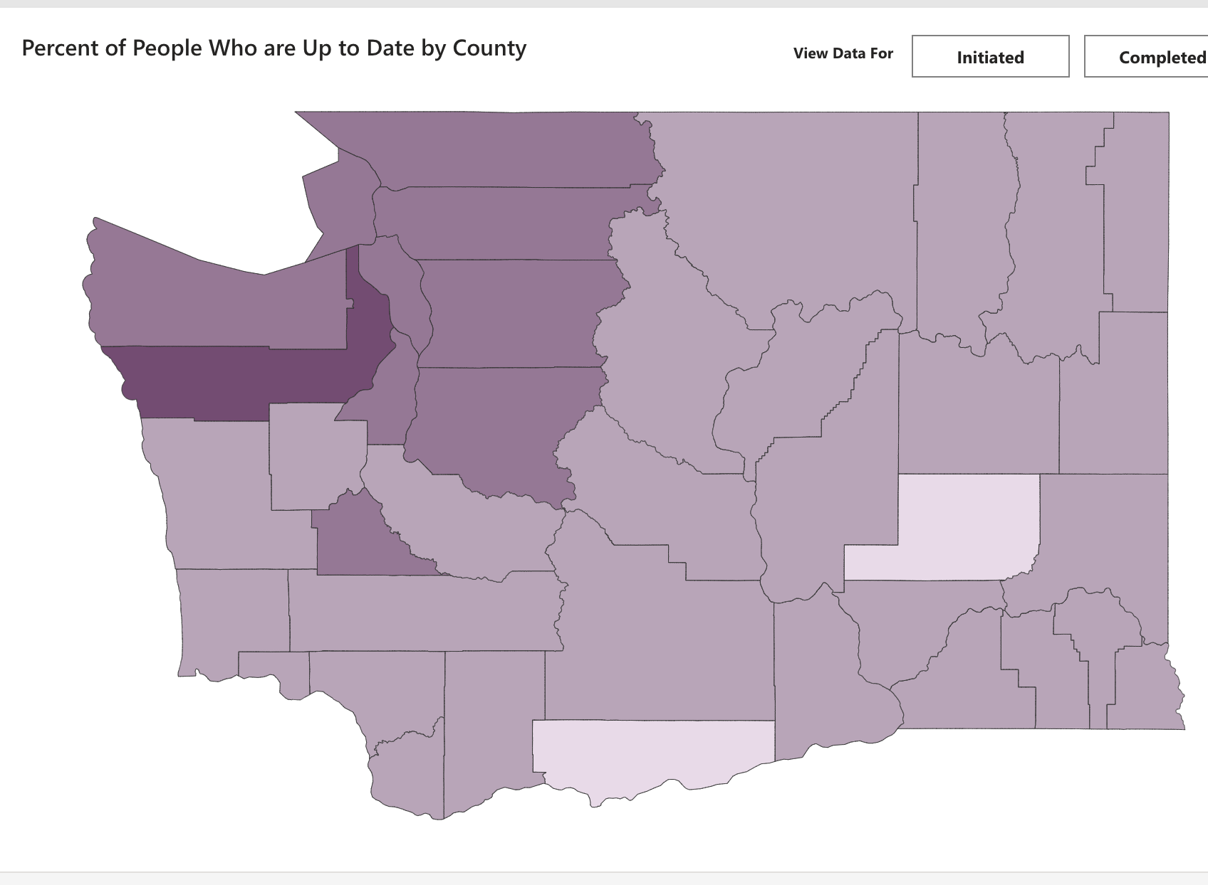
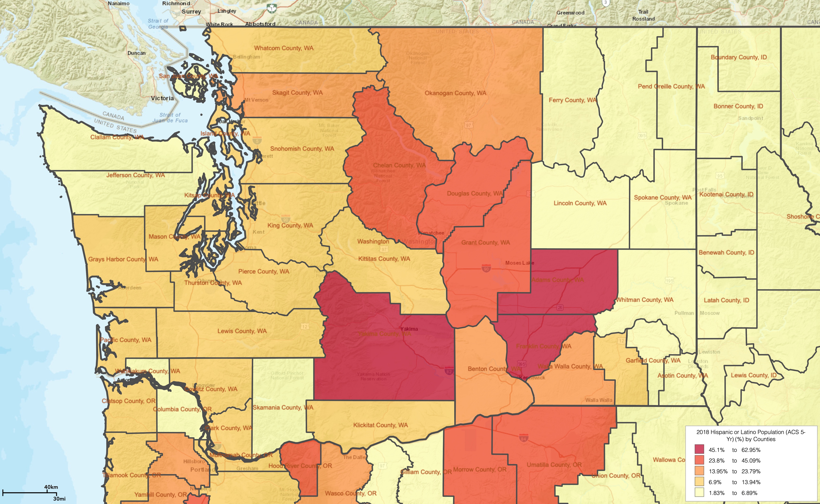
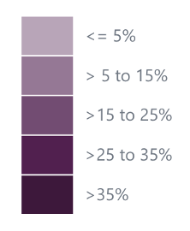
Percentage of Residents Up to Date by County as of 01.01.2024
WA Latino Population by Share of Population, 2018

Slide 8
Long COVID STUDY COLLABORATORS
Latino Center for Health, UW
SeaMar Community Health Centers
Yakima Valley Farm Workers Clinic
Allen Institute for Immunology
UW Medicine Long COVID Clinic

Slide 9
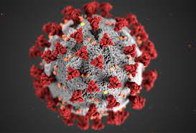
STUDY MOTIVATION
Latinos in WA have experienced high rates of infection, hospitalization, and mortality due to COVID-19.
Latinos have high rates of risk factors for long COVID including obesity, HTN, DM and CVD.
Data on Long COVID among Latinos is limited, despite elevated risk factors.

Slide 10
WHAT IS LONG COVID?
Persisting symptoms 3 months after initial COVID infection that aren’t explained by other medical conditions.
Symptoms can be new after recovering from acute COVID or persist from the initial illness.
Symptoms may fluctuate or relapse over time.
Lack of laboratory or imaging abnormalities does NOT invalidate the existence, severity, or importance of a patient’s symptoms or conditions.
Symptoms
World Health Organization (WHO) and CDC definitions
Notes:
Focusing on serving a broader population of patients and improving access for vulnerable populations

Slide 11
STUDY ELIGIBILITY
SeaMar and YVFWC patients
18+ years of age
COVID DX: 1/1/2020 to 12/31/2022
Latino/Hispanic ethnicity
Clinic visit in last 6 months
English or Spanish language preference

Slide 12
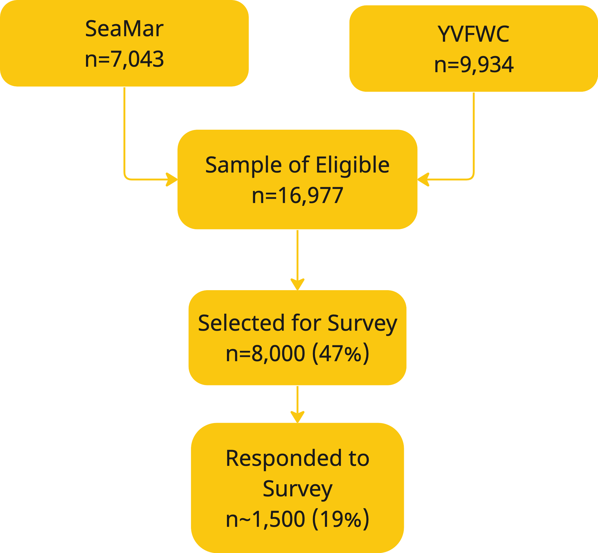
Long COVID Study Sample
Oversampled older patients
Oversampled males
Oversampled delta variant
Geographic balance
N=1546
Notes:
EDIT: Use final numbers (n interim, N final) ---- breakdown interim 1099, final ____ from last box

Slide 13
Key Findings
41% of study population reported long COVID
27% of those with long COVID had current sx
Women (50%) > men (36%)
Middle age (44%) > younger (41%) > older (31%)
Unvaccinated (48%) > vaccinated (39%)
Multiple infections (52%) > single infection (36%)

Slide 14
SES Correlates
 | % of Study Population | % Reporting Long COVID
Financially insecure | 65% | 47%
Food Insecure | 17% | 51%
Uninsured | 29% | 46%
Spanish preferred | 60% | 44%

Slide 15
Top Symptoms
Fatigue (40%)
Dizziness (35%)
Muscle pain (35%)
Shortness of breath (33%)
Anxiety (31%)
Sleep disturbances (25%)
Brain fog (20%)

Slide 16
Prevalence of Obesity Among Youth and Adults in United States, 2015-2016
Obesity (BMI>30)
Source: Yeyi Zhu, Margo A. Sidell, David Arterburn, Matthew F. Daley, Jay Desai, Stephanie L. Fitzpatrick, Michael A. Horberg, Corinna Koebnick, Emily McCormick, Caryn Oshiro, Deborah R. Young, Assiamira Ferrara; Racial/Ethnic Disparities in the Prevalence of Diabetes and Prediabetes by BMI: Patient Outcomes Research To Advance Learning (PORTAL) Multisite Cohort of Adults in the U.S.. Diabetes Care 1 December 2019; 42 (12): 2211–2219.
SOURCE: Hales CM, Carroll MD, Fryar CD, Ogden CL. Prevalence of obesity among adults and youth: United States, 2015–2016. NCHS data brief, no 288. Hyattsville, MD: National Center for Health Statistics. 2017.
(Data: National Health and Nutrition Examination Survey, 2015–2016)

Slide 17
Diagnosed, Undiagnosed and Total Diabetes among Adults Aged 20 and Over
United States, 2015-2018

Slide 18
Depression and Anxiety Among Latino Adults in WA
Anxiety
Depression
Source: US Census Pulse Survey, Week 63, 10.18.202 3 -10.30.23

Slide 19
Social Determinants of Health
Economic Security
Meeting Household Expenses
Health Insurance
Food Security
59%
72%
Source: US Census Pulse Survey, Week 63, 10.18.2023 -10.30.23

Slide 20
People without a usual source of care, 2018 (lower rates are better)
Uninsured
Undocumented
Source: 2021 National Healthcare Quality and Disparities Report. Rockville, MD: Agency for Healthcare Research and Quality; December 2021. AHRQ Pub. No. 21(22)-0054-EF.

Slide 21
Addressing Challenges Facing Latino Communities (RECOMMENDATIONS)
Expand no-cost community COVID-19 vaccine efforts by restoring funding for the Care-a-Van mobile health program.
Expand provider and community education on Long COVID, in addition into greater investment in clinical care for long COVID.
Expand community-based screening for obesity, prediabetes, diabetes, and hypertension with navigation assistance for receipt of medical care (expand telehealth for rural and underserved).
Fully fund state Medicaid-like and health insurance exchange programs for undocumented immigrants and refugees.
Expand access to bilingual/bicultural mental health providers.

