Slide 1
Latinx Workforce for Washington State October 9, 2023
Leo S. Morales, MD, PhD
Professor and Assistant Dean for Healthcare Equity and Quality
Office for Healthcare Equity, UW Medicine
Co-Director, Latino Center for Health
University of Washington
Notes:
No disclosures
Opinions are my own – I am not speaker for UW Medicine or the University of Wahington

Slide 2
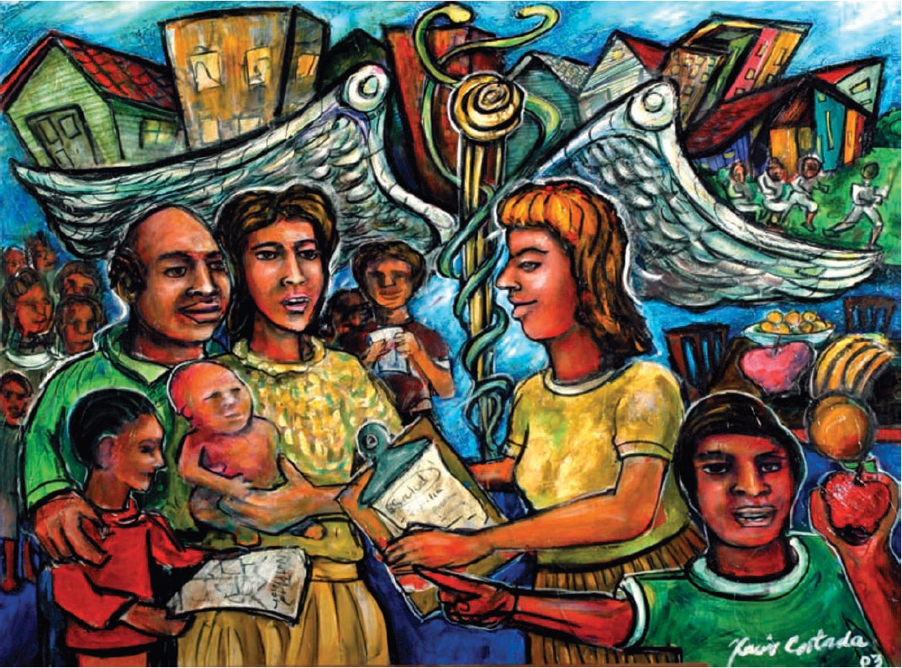
A state-supported interdisciplinary research center at the University of Washington
We conduct community-engaged research through capacity building and authentic partnerships with community stakeholders to promote the health and well-being of Latino communities in WA state
Through our impactful research, we intentfully inform policy and practice
The center is housed administratively within the School of Social Work

Slide 3
A Healthcare Workforce that is inclusive of Latinx People is Necessary to achieve Health Equity
Linguistic and cultural concordance results in better healthcare for Latino patients with and without limited English proficiency.
Ngo-Metzger Q, Sorkin DH, Phillips RS, Greenfield S, Massagli MP, Clarridge B, Kaplan SH. Providing high-quality care for limited English proficient patients: the importance of language concordance and interpreter use. J Gen Intern Med. 2007 Nov;22 Suppl 2(Suppl 2):324-30.
Waibel S, Wong ST, Katz A, Levesque JF, Nibber R, Haggerty J. The influence of patient-clinician ethnocultural and language concordance on continuity and quality of care: a cross-sectional analysis. CMAJ Open. 2018;6(3):E276-E284. Published 2018 Jul 19. doi:10.9778/cmajo.20170160
Latino physicians are more likely to practice in underserved communities.
Marrast LM, Zallman L, Woolhandler S, Bor DH, McCormick D. Minority physicians' role in the care of underserved patients: diversifying the physician workforce may be key in addressing health disparities. JAMA Intern Med. 2014 Feb 1;174(2):289-91.
Komaromy M, Grumbach K, Drake M, Vranizan K, Lurie N, Keane D, Bindman AB. The role of black and Hispanic physicians in providing health care for underserved populations. N Engl J Med. 1996 May 16;334(20):1305-10.

Slide 4
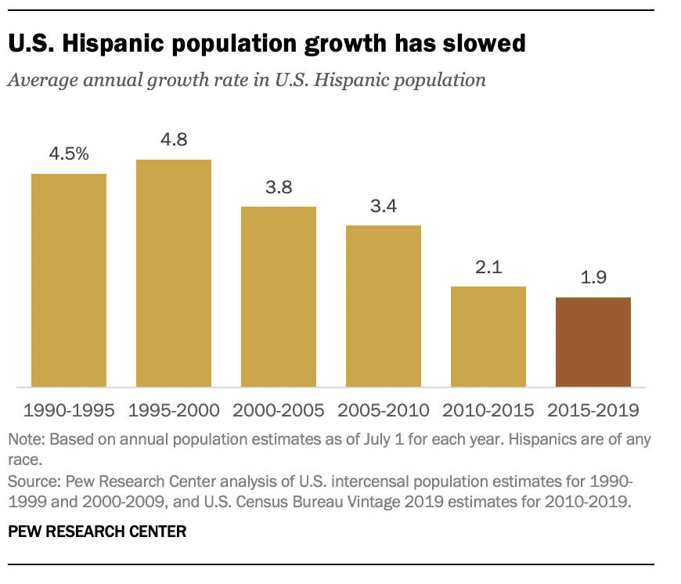
Hispanic Population Growth
62-65
2023

Slide 5
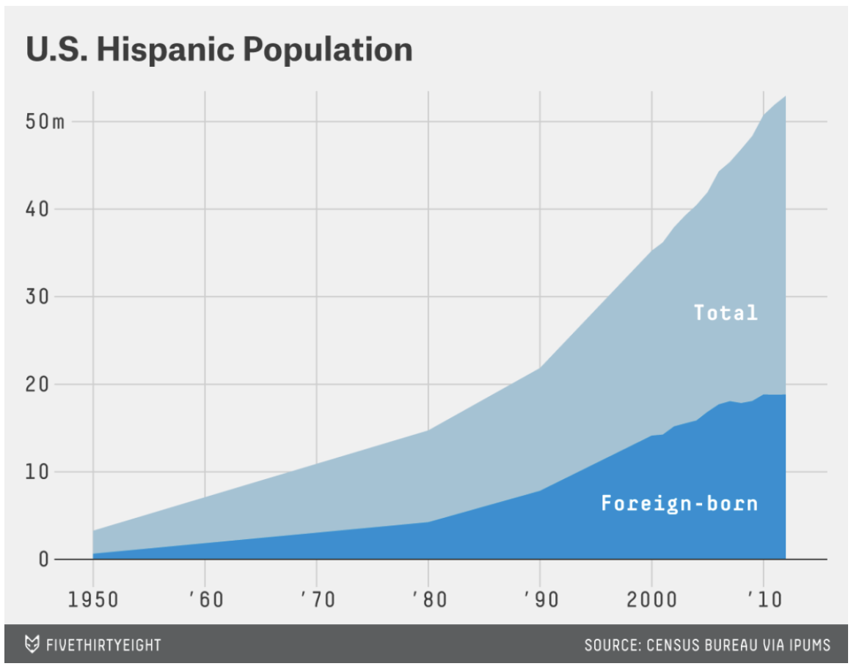
Births Overtake Immigration Hispanic Population Growth,1970-2018
Notes: U.S. births and immigrations reflect additions to the U.S. Hispanic population. Deaths and emigration not shown. Source: Based on Pew Research Center tabulations of 2015 American Community Survey (1% IPUMS) for 2010-2015, and of the 2010 American Community Survey (1% IPUMS) for 2000s. Data for 1970s, 1980s and 1990s drawn from Pew Research Center historical projections (Passel and Cohn, 2008).

Slide 6
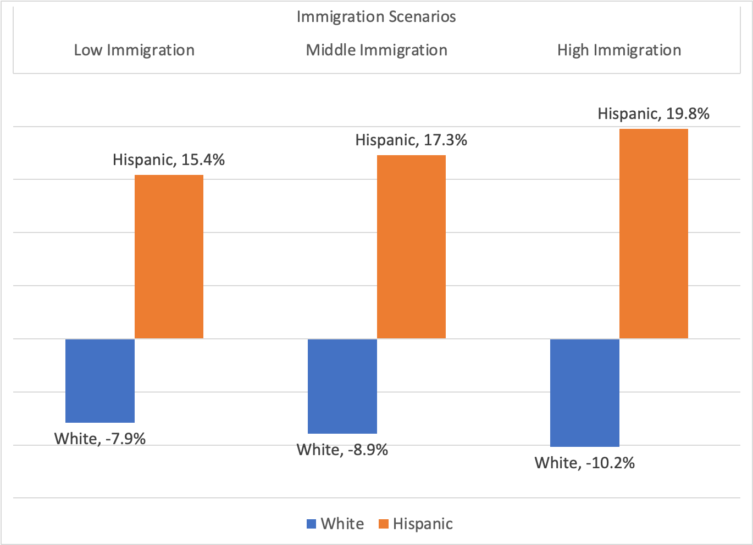
Projected increases in the Latino Share of the US Population Between 2016 and 2060 by Immigration Scenario
Source: Johnson, Sandra, “A Changing Nation: Population Projections Under Alternative Migration Scenarios,” Current Population Reports, P25-1146, U.S. Census Bureau, Washington, DC, 2020.

Slide 7
Latino Population by National Origin, United States, 2021
Peruvian, 17%
Colombian, 32%
Ecuadorian, 19%
Venezuelan, 15%
Washington State
Guatemalan, 28%
Salvadoran, 39%
Honduran, 18%
Mexican | 782,899 | 76%
Puerto Rican | 39,291 | 4%
Cuban | 11,637 | 1%
Central American | 65,746 | 6%
Guatemalan | 21,060 | 2%
Honduran | 9,120 | 1%
Salvadoran | 25,218 | 2%
South American | 37,140 | 4%
Colombian | 11,273 | 1%
Peruvian | 8,166 | 1%
Spaniard | 24,012 | 2%
Source: ACS 1-Year Estimates Subject Tables, 2021

Slide 8
Latinos Will Account for an Increasing Share of The Population 65 and Older

Slide 9
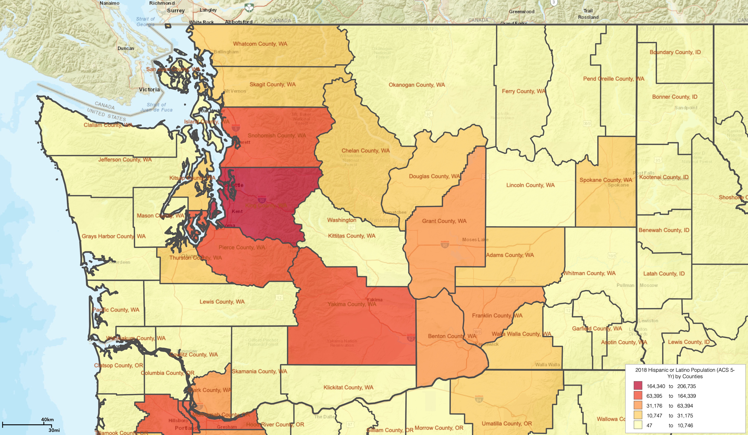
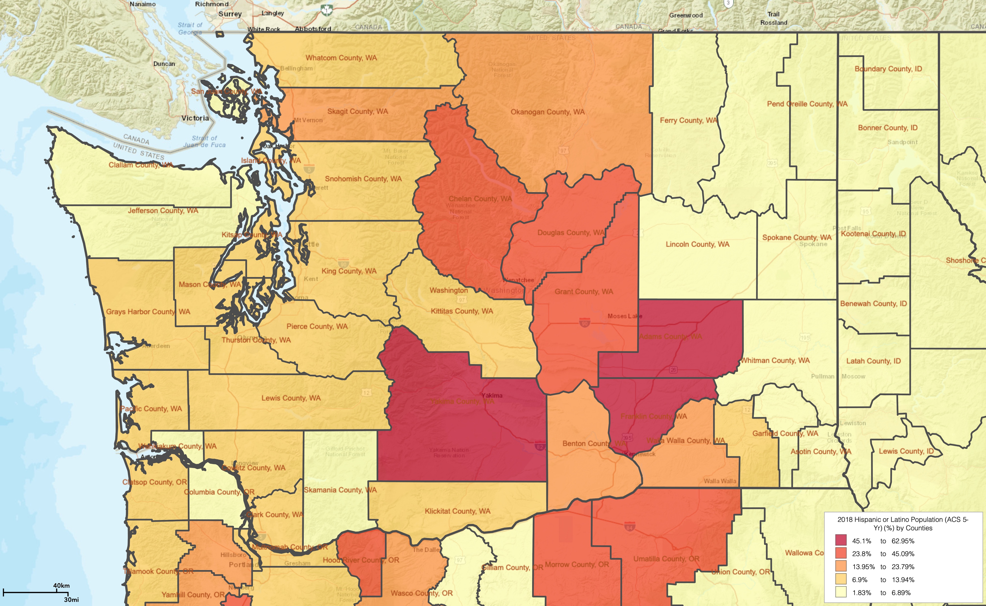
WA Latino Population Distribution, 2022
By Number (Total Number 1,093,313)
By Share (14% of WA State)

Slide 10
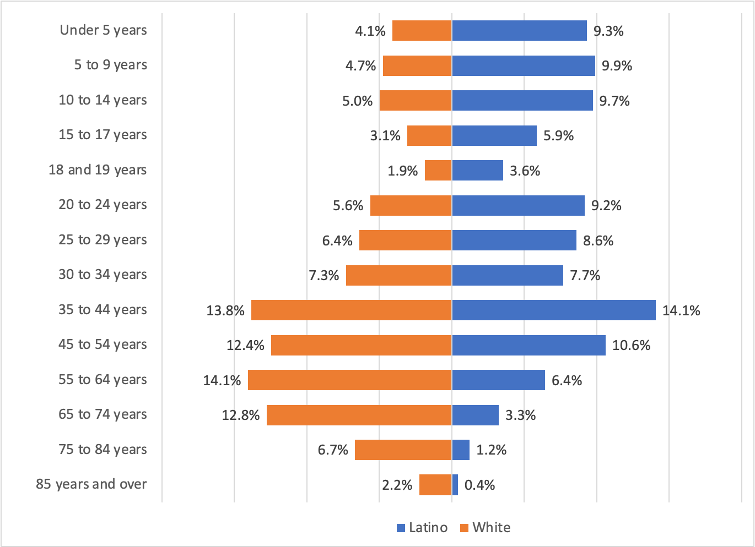
Age Distribution of Latino Population of Washington State, 2022
K-12 Aged Children
College-Aged Young Adults
Source: U.S. Census Bureau, 2022 American Community Survey 1-Year Estimates
Notes:
Latinos are a young population with a large share of its population in school and college aged children and adolescents

Slide 11
Spanish Language Use at Home is Common, WA, 2021
U.S. Census Bureau. "AGE BY LANGUAGE SPOKEN AT HOME BY ABILITY TO SPEAK ENGLISH FOR THE POPULATION 5 YEARS AND OVER." American Community Survey, ACS 5-Year Estimates Selected Population Detailed Tables, Table B16004, 2021, . Accessed on October 8, 2023.
Notes:
Spanish language use is an indicator of cultural affiliation.
Limited English proficiency is an indicator of need for linguistic access.

Slide 12
Latino Representation in Healthcare Occupations and Professions
Diagnosing the Treating Professions
US Workforce
Mexican Americans - 10.7%
Puerto Ricans - 1.6%
Cuban Americans - 0.8%
Other Latinos - 4.8%
Source: Islas IG, Brantley E, Portela Martinez M, Salsberg E, Dobkin F, Frogner BK. Documenting Latino Representation In The US Health Workforce. Health Aff (Millwood). 2023 Jul;42(7):997-1001. doi: 10.1377/hlthaff.2022.01348. PMID: 37406235.
*PT, OT, Speech-Language

Slide 13
Latino Representation in Healthcare Occupations and Professions
Health care support, personal care and service occupations
US Workforce
Mexican Americans - 10.7%
Puerto Ricans - 1.6%
Cuban Americans - 0.8%
Other Latinos - 4.8%
Source: Islas IG, Brantley E, Portela Martinez M, Salsberg E, Dobkin F, Frogner BK. Documenting Latino Representation In The US Health Workforce. Health Aff (Millwood). 2023 Jul;42(7):997-1001. doi: 10.1377/hlthaff.2022.01348. PMID: 37406235.
Notes:
Latinos are making more progress entering supporting healthcare occupations than the (better paid) treating and diagnosing professions

Slide 14
Latino Presence in Educational Pipeline, 2010-12 and 2019-2021
Notes:
Some progress, but still underrepresented as indicated by a DI<1.0

Slide 15
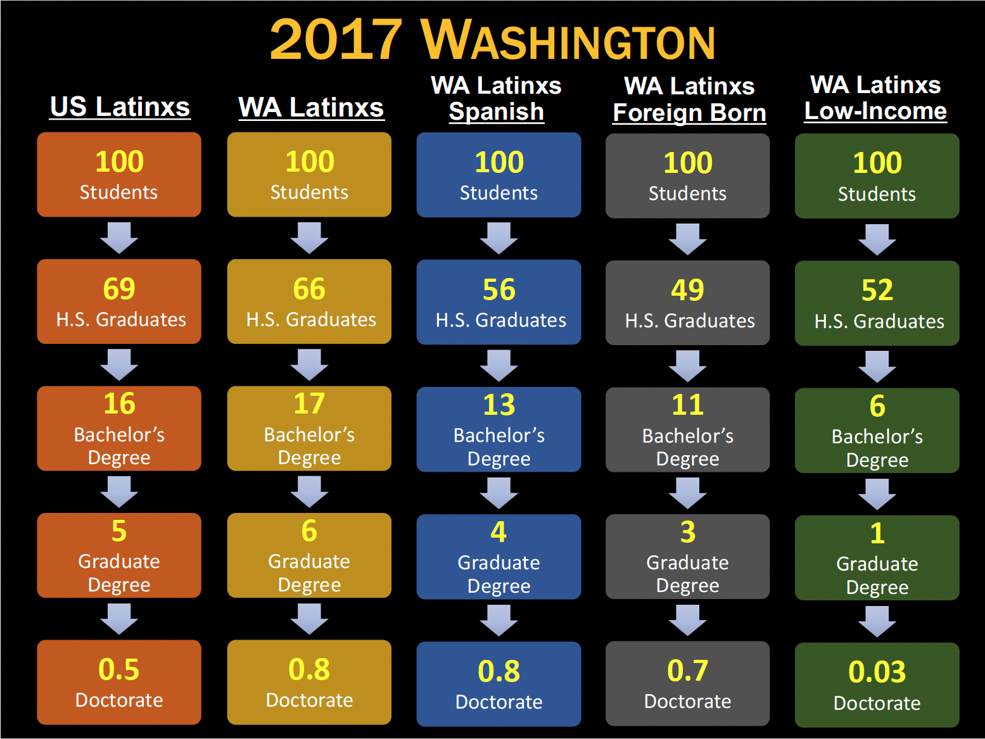
39
will start at a Community College
Source: Veronica Velez, PhD, WWU
Notes:
Community Colleges play a key role in higher education for Latinos and need to be recognized as a stepping stone to advanced degrees
Latino students with low-income backgrounds are struggling the most in graduating high school and reaching higher education.

Slide 16
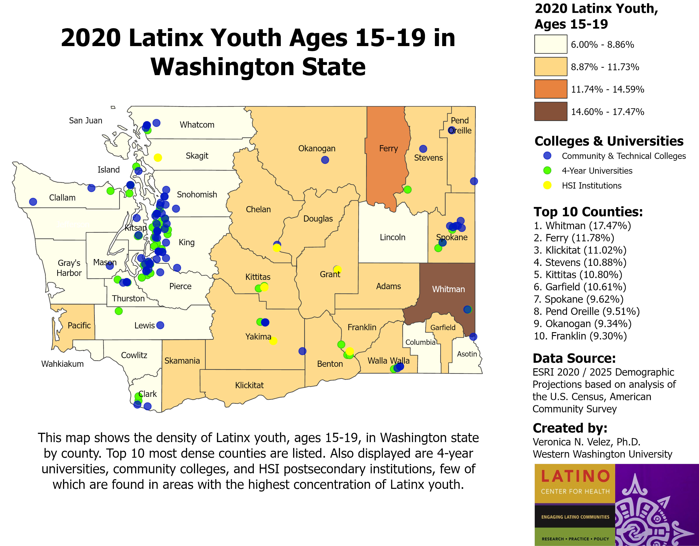

Slide 17
ACGME Residents, United States, 2021
(N=152,043)
US Medical Students, United States, 2018-19
(N=21,622)
Latinx Population 20-30 years of age: 23%
Source: ACGME Data Resource Book
Source: AAMC Diversity Data Report

Slide 18
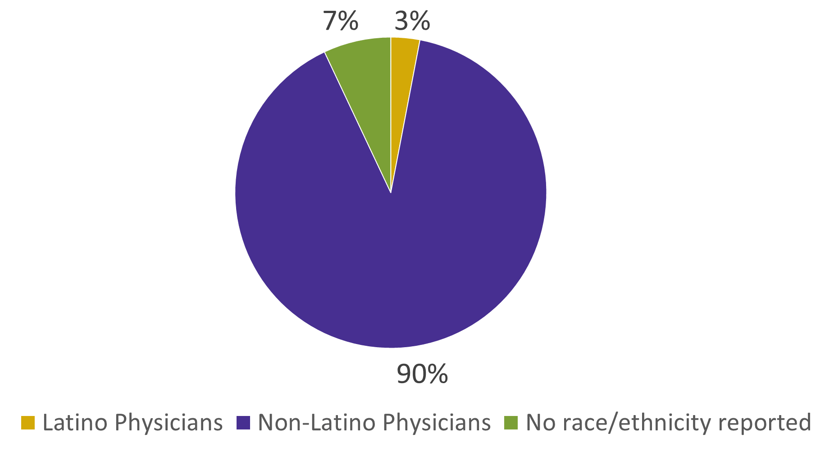
Latino Physicians Only Constitute 3% of the MD Workforce in WA
Physician to Population Ratios:
Latino Physicians: 45 per 100,000 Latino Population
White Physicians: 277 per 100,000 per White Population
 | N (%)
Latino Physicians | 462 (3.1%)
Non-Latino Physicians | 13,208 (89.7%)
No race/ethnicity reported | 1,061 (7.2%)
Notes:
Only 3% of physicians in WA are Latino/Hispanic resulting in
Latino Physicians: 45 per 100,000 Latino Population
White Physicians: 277 per 100,000 per White Population

Slide 19
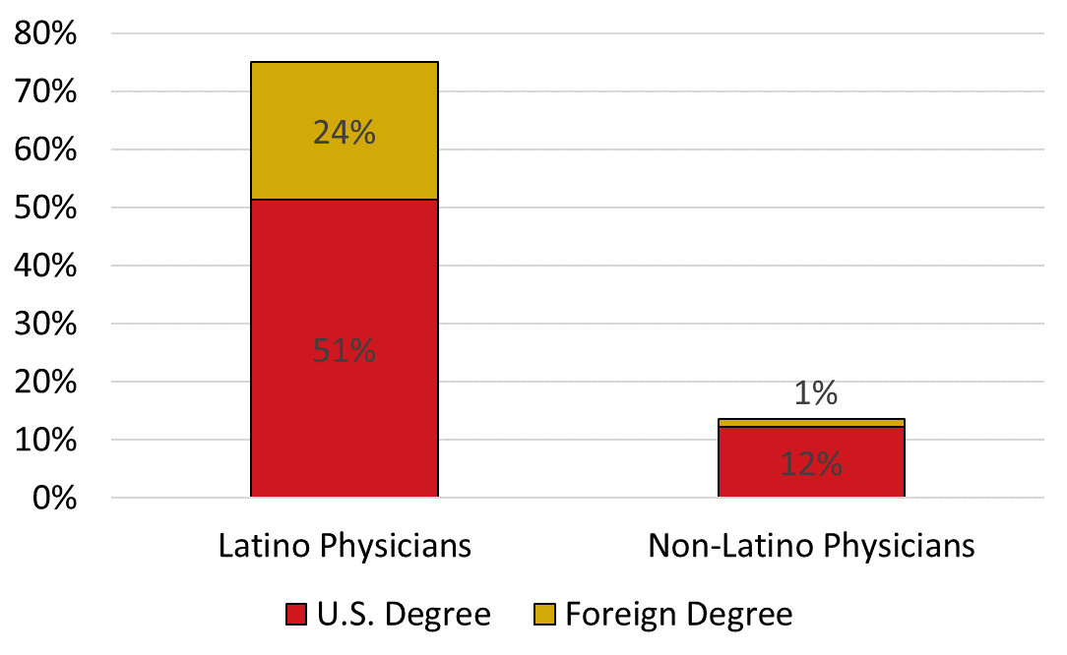
75% of Latino Physicians Speak Spanish in Washington State
 | Latino Physicians (N=462)
Speaks Spanish, n (%) | 347 (75.1%)
U.S. Degree | 237 (51.3%)
Foreign Degree | 110 (23.8%)
Notes:
Among Latino physicians, 75% they speak Spanish well enough to care for patients without the need for interpreters as compared to 13% of non-Latino physicians.
Foreign medical school gradates are in important part of the Spanish speaking physician workforce in WA.

Slide 20
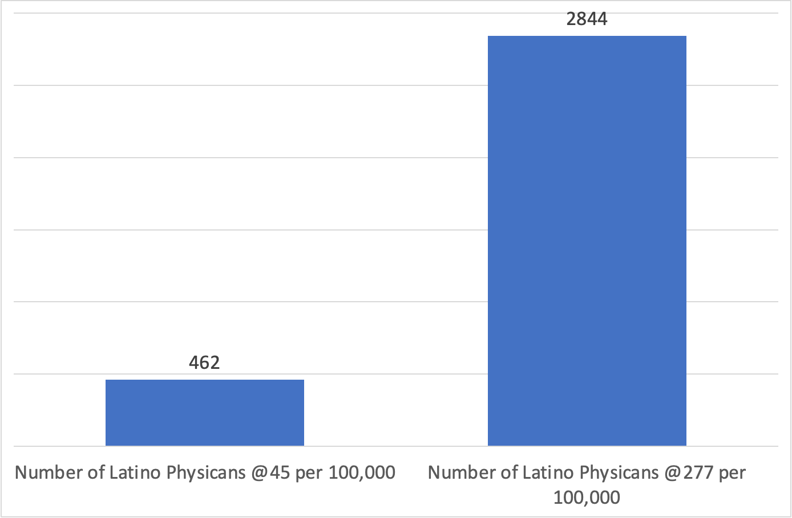
Latino Physician Projections
2020-2040
20%
Parity
10%
𝛥=2,382
3%
5%
Notes:
To reach parity with the white MD to population ratio, we would need to add 2,382 Latino physicians
Even if we grow the Latino physician workforce by 20% per 5 years, we only reach a ration of 59 Latino MDs per 100,000 population by 2040.
At 3%, 5%, and 10% increase per 5 years, the ratio in the state drops from 45 per 100,000 to 32, 35 and 42 per 100,000.

Slide 21
Summary
The need for more Latino physicians and other treating and diagnosing professionals is urgent and necessary to improve the health of our communities.
Community and technical colleges play a critical role in helping Latino students attain higher education.
Programs to provide stepping stones from supporting occupations to diagnosing and treating professions are needed.
Rather than seek to recruit Latino students from out-of-state, our universities should focus on Latino students in our state.

