Slide 1
Caring for patients with Post COVID conditions: Current Evidence and Clinical Practice
Janna Friedly, MD, MPH
Professor and Chair
Department of Rehabilitation Medicine, University of Washington
Executive Director, UW Post-COVID Rehabilitation and Recovery Clinic
November 3, 2023

Slide 2
Acknowledgments
The University of Washington acknowledges the Coast Salish peoples of this land, the land which touches the shared waters of all tribes and bands within the Suquamish, Tulalip and Muckleshoot nations.
https://www.realrentduwamish.org/land-acknowledgement.html

Slide 3
Disclosures
No financial disclosures related to this talk
Related grant funding:
AHRQ

Slide 4
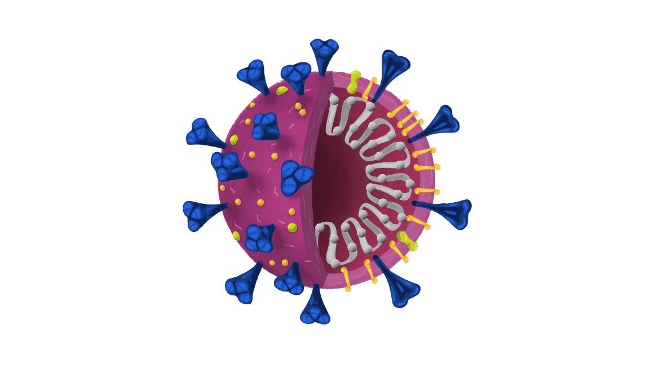
Updated Evidence
1. Explore the latest research on pathophysiology of Long COVID.
2. Discuss management strategies for Long COVID.
Notes:
I am a PASC Clinician, Editor, Patient, Researcher

Slide 5
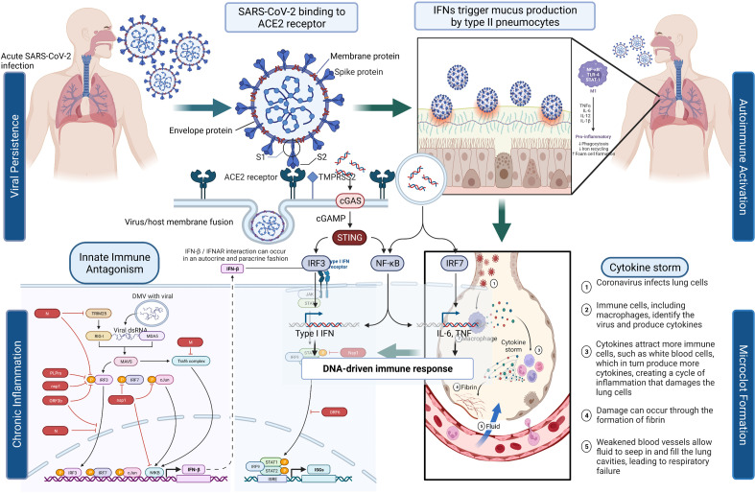
What Causes Long COVID?
Sherif ZA 2023
RECOVER Mechanistic Pathway Task Force

Slide 6
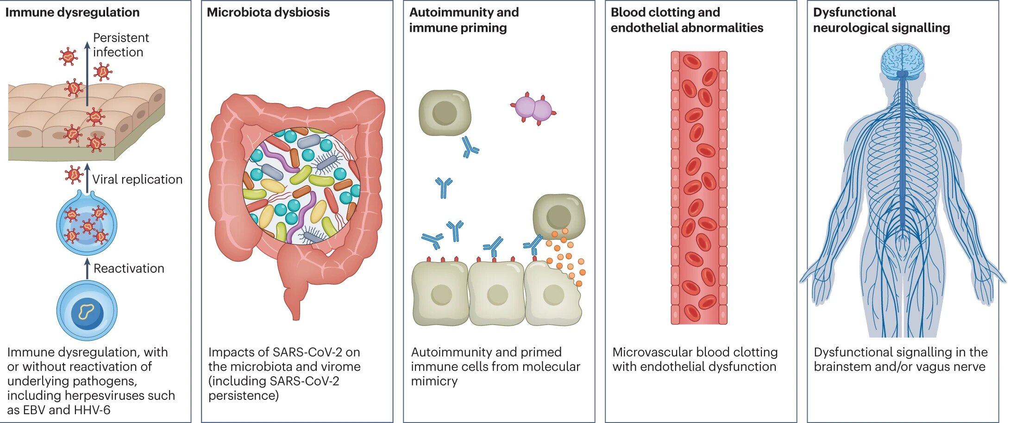

Slide 7
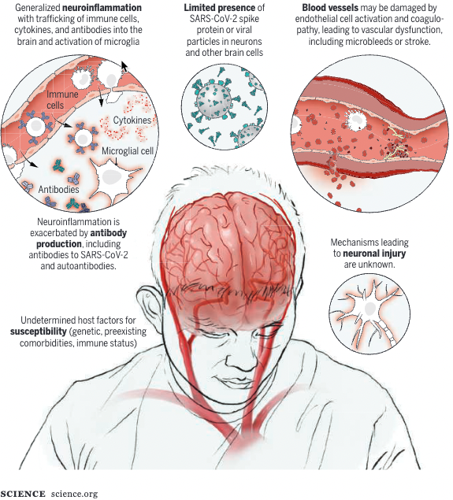
Neuro Inflammation
CSF and brain tissue suggest immune activation and inflammation in CNS
Upregulation of cytokines in CNS
Inappropriate activation of microglia and astrocytes
Spudich S, Nath A. Science. 2022;375(6578):267-269.
Xu E, Xie Y, Al-Aly Z.. Nat Med. Published online September 22, 2022:1-10.

Slide 8
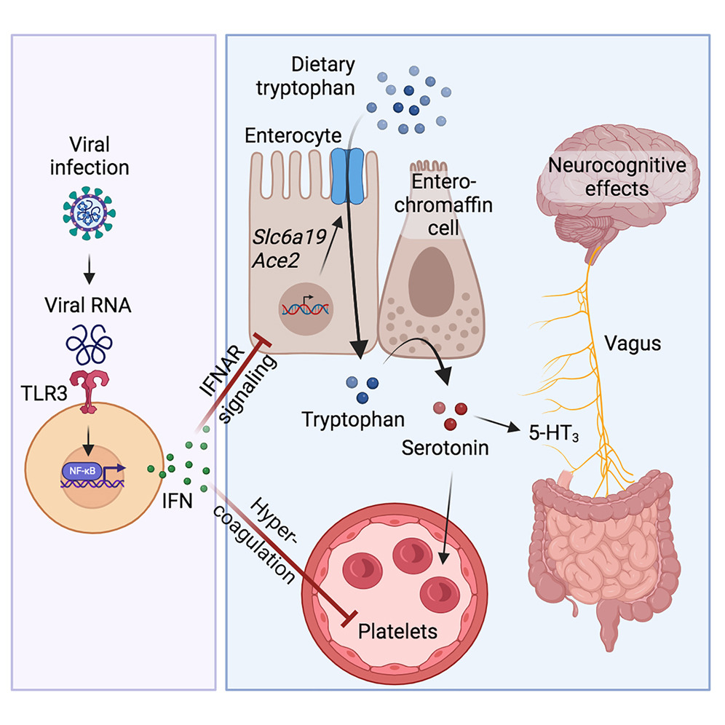
Serotonin reduction in post-acute sequelae of viral infection
Cell 2023 1864851-4867.e20DOI: (10.1016/j.cell.2023.09.013)
Notes:
ryptophan is a building block for several neurotransmitters, including serotonin, which is primarily produced in the GI tract and carries messages between nerve cells in the brain and throughout the body. It plays a key role in regulating memory, sleep, digestion, wound healing, and other functions that maintain homeostasis within the body. Serotonin is also an important regulator of the vagus nerve, a system of neurons that mediate the communication between the body and the brain.
The researchers found that when tryptophan absorption is reduced by persistent viral inflammation, serotonin is depleted, leading to disrupted vagus nerve signaling, which in turn can cause several of the symptoms associated with long COVID, such as memory loss.
ryptophan is a building block for many other important metabolites, like niacin, which helps the body turn food into energy, and melatonin, a hormone which regulates circadian rhythms and sleep.

Slide 9
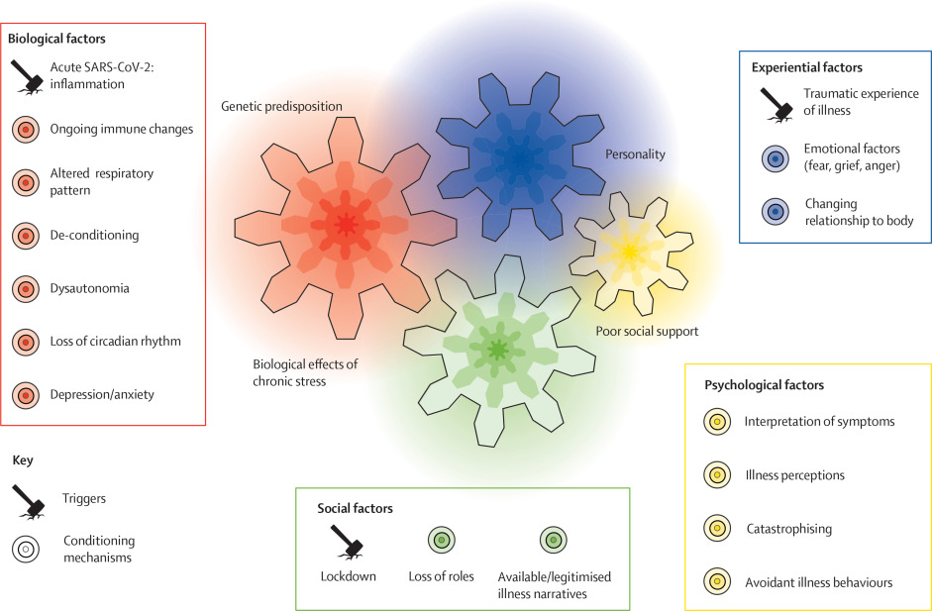
Saunders et al., 2023
Notes:
propose a third response that allows for a more complex understanding of the reciprocal relationships between triggers, conditioning mechanisms, and symptoms.
What does the patient bring to the illness or condition?
A behavioral process whereby a response becomes more frequent or more predictable in a given environment as a result of reinforcement,

Slide 10
Post-Acute Sequelae of COVID (PASC) Symptoms
Disrupted Immunity
Inflammation
Nervous System Dysfunction
Shortness of breath
Hormonal imbalance
Brain fog
Chest discomfort
Dizziness
Watery eyes
Reflux
Sinusitis
Sleep disturbance
Anxiety
Depression
Autonomic nervous system dysregulation
Cough
Nausea
Headaches/Migraine
Diarrhea
GI symptoms
Body aches
Allergic rhinitis
HR/BP instability
Joint swelling
Pain
Memory issues
Fatigue
Decreased endurance
Notes:
This is a graphic that I think is helpful to depict how interrelated the symptoms are and to help patients to understand how seemingly very disparate symptoms can all be related and are not necessarily signals that there is organ damage – most often it isn’t a primary lung or heart problem, but rather a more systemic effect of the immune system response and requires a holistic approach to make headway.

Slide 11
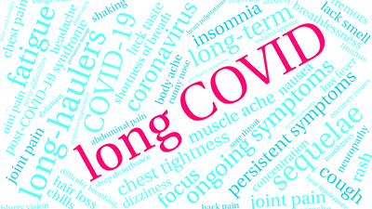
Updated Evidence
1. Explore the latest research on pathophysiology of Long COVID.
2. Discuss management strategies for Long COVID.
Notes:
I am a PASC Clinician, Editor, Patient, Researcher

Slide 12
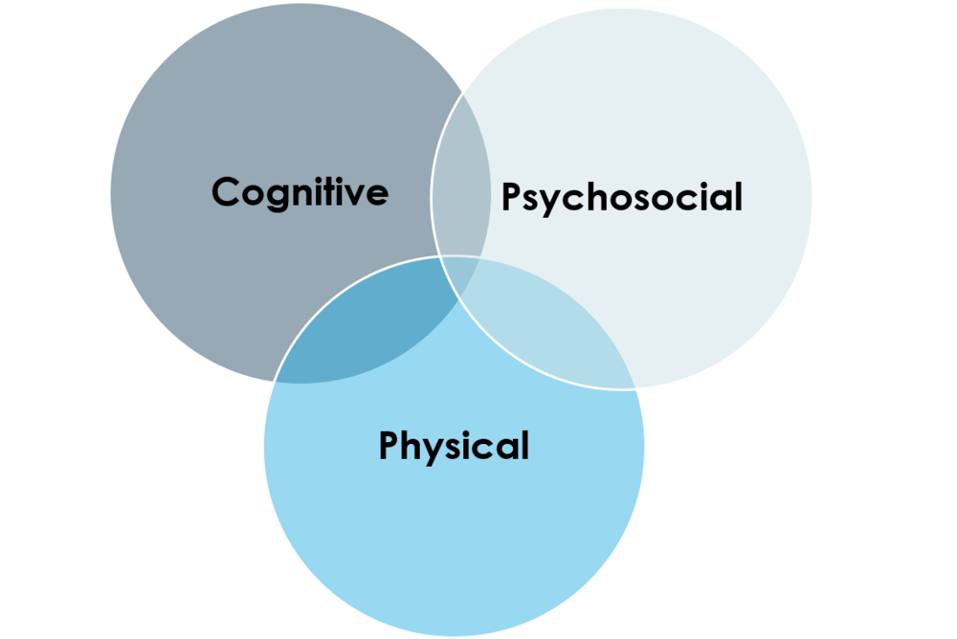
Can Long COVID be treated?
No universal treatment of post-COVID symptoms (yet!)
Patients present very differently, so treatment must be tailored
In general, holistic rehabilitation approaches that combine breathing exercises, physical activity/exercise, self-management and behavioral health strategies are more promising than any single medication

Slide 13
Ongoing Treatment Studies: clinicaltrials.gov
Curcumin/Boswellia/Serrata/Ascorbic Acid
Monoclonal Ab tx
Paxlovid
Homeopathic tx
Prospekta
Lyt-100 - Deupirfenidone
TENS
tDCS
Vitamin C drops
Inspiratory muscle Training
Physical Training
Cardiopulmonary rehab
AXA1125 – oral amino acid mixture
CBDRA60 – cannabidiol/Gigartina red algae
COVI-MS – stem cell tx
ExoFlo – stem cell infusion
Enhanced external counterpulsation
Vagus nerve stimulation
Low Dose Naltrexone
S-1226 – bronchodilator and synthetic surfactant
BREATHE – virtual self management
Mobile app for rehab
Mindfulness
HEARTLOC: HR variability biofeedback
Metoprolol
Vortioxetine – antidepressant
Omega 3 supplement
Lithium
Chiropractic care
Nicotinamide Riboside
Health behavior coaching
Qigong
Nitrite supplement
SingStrong
Mindfulness
Acupuncture
Exercise with blood flow restriction, cooling, high dose oxygen+ infrared therapy
UW Research:
RSLV-132 – RNA immune modulator
Project ECHO vs MDR clinic
Rehab psychology group sessions
Acupuncture

Slide 14
PASC Holistic Treatment Approach
Mental Health (Anxiety, Depression)
Diet / Substances
Sleep
Tailored, Restorative Exercise
No evidence re: ideal diet
Anti-inflammatory
Few processed foods
Fewer calories from animal fats
Liberal fruits, vegetables and high-quality oils
Low in sugar / processed flour / “energy drinks”
Drink enough water
Substances (Significant sleep and mental health impacts)
Low or no alcohol
Avoid caffeine after noon, limit overall intake
Address other substance dependence
Sleep a major contributor to fatigue (~45% of patients report insomnia)
Assessment: PROMIS Sleep, STOP-Bang
Sleep hygiene
Consider short-term pharmacotherapy
Melatonin, Trazodone first line
Cognitive behavioral therapy for insomnia (CBT-I) if available
Avoid PEM, caution with POTS and ME/CFS symptoms

Slide 15
Mental Health (Anxiety, Depression)
Diet / Substances
Sleep
Tailored, Restorative Exercise
Specific management options
Diet and Supplements
Notes:
I am a PASC Clinician, Editor, Patient, Researcher

Slide 16
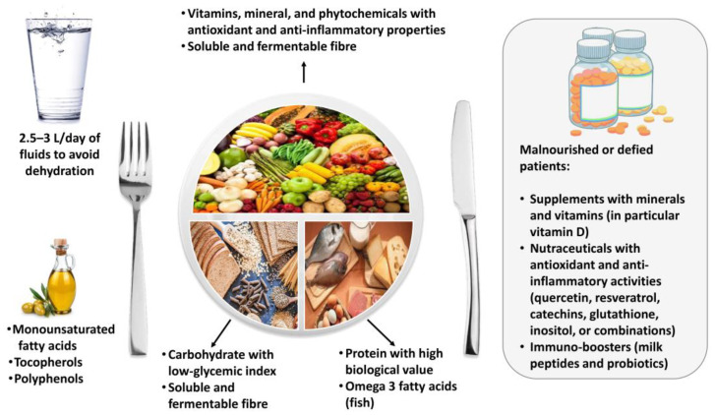
How I approach diet and supplements (evolving):
Best to get nutrients through diet

Slide 17
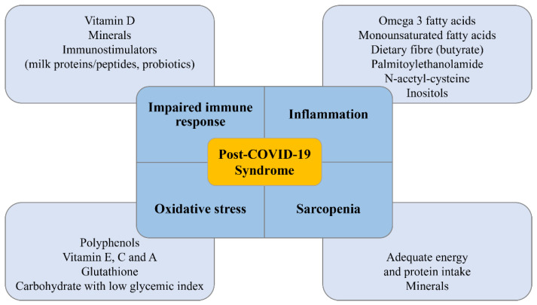
Supplements
Many theoretical reasons why a variety of supplements may be helpful in long COVID.
Bottom line: no clinical trial data to guide which are most effective and how to take them for biggest effect
Barrea L, Grant WB, Frias-Toral E, Vetrani C, Verde L, de Alteriis G, Docimo A, Savastano S, Colao A, Muscogiuri G. Dietary Recommendations for Post-COVID-19 Syndrome. Nutrients. 2022 Mar 20;14(6):1305. doi: 10.3390/nu14061305.

Slide 18
Supplements
If diet is restricted/poor, will check for vitamin deficiencies (if not already supplementing)
If fatigue, Vit D and iron levels
If neurologic symptoms, Vit B12
If $$ is not limited:
Coenzyme Q10 and NADH: reduces fatigue in ME/CFS
Castro-Marrero J, et al. Effect of Dietary Coenzyme Q10 Plus NADH Supplementation on Fatigue Perception and Health-Related Quality of Life in Individuals with Myalgic Encephalomyelitis/Chronic Fatigue Syndrome: A Prospective, Randomized, Double-Blind, Placebo-Controlled Trial. Nutrients. 2021 Jul 30;13(8):2658.
Tumeric/curcumin: anti inflammatory
Mixed results in specific conditions, but likely helpful in inflammatory conditions including with cognitive decline
Vitamin D: reduces risk of autoimmune conditions/anti-inflammatory
Dong Y, et al. Effects of Vitamin D₃and Marine Omega-3 Fatty Acids Supplementation on Biomarkers of Systemic Inflammation: 4-Year Findings from the VITAL Randomized Trial. Nutrients. 2022 Dec 14;14(24):5307.
Probiotics: anti inflammatory
Many studies on inflammatory GI conditions, depression, cognitive impairment, other symptoms

Slide 19
Specific management options
Autonomic nervous system dysregulation: dysautonomia
Notes:
I am a PASC Clinician, Editor, Patient, Researcher

Slide 20
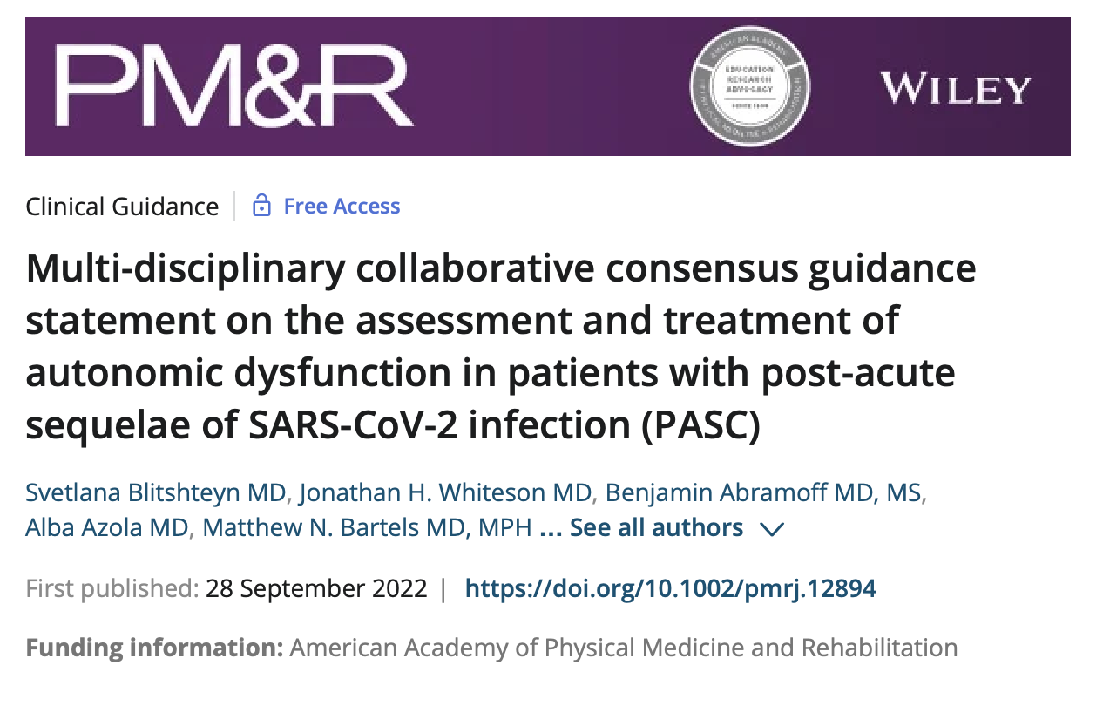
PASC Consensus Guidance Statements
April 2021-June 2023
Methodology
Fatigue
Cognitive Symptoms
Breathing Discomfort
Cardiovascular Complications
Clinic Infrastructure
Children and Adolescents
Autonomic dysregulation
Neurologic symptoms
Upcoming:
Mental health considerations

Slide 21
Dysautonomia
Orthostatic presyncope
Tachycardia
Palpitations
Chest pain
Tremor
Headaches
Anxiety
Sweating
Cold hands/feet
Nausea/Vomiting
Constipation
Diarrhea
Gastroparesis
Food intolerances
Myalgias/Pain
Brain Fog
Flushing
Fatigue
Triggers
Prolonged Standing
Warm environments
Upright exercise
Large Meals
Some medications
Alcohol
Stress
Exclude
Anemia
Thyroid Disorders
Adrenal Insufficiency
Medication effects

Slide 22
Postural Orthostatic Tachycardia Syndrome (POTS): Diagnosis
Method | Description | Criteria | Advantage/disadvantage
Orthostatic Vital Signs | Measure VS’s lying, and then standing after 2 and 5 minutes | Increase in heart rate of ≥30 beats per minute (bpm) or ≥40 in children/adolescents; no drop in SBP >20 mmHg or DBP >10 mmHg | Easy to do. Sufficient for dx
NASA Lean test | Measure vital signs with standing, with feet 20 cm from wall over ten minutes | Same as above, symptoms of lightheadedness | More sensitive, but more time consuming.
Autonomic Testing: Tilt table test (Gold Standard) | Pt is placed on table, gradually becoming more supine, VSs are measured.Catecholamines may be measured as well, and sweat activity (QSART) | Reproduction of symptoms, change in vital signs, increased sweating | Gold standard, but limited availability, available only through specialists

Slide 23
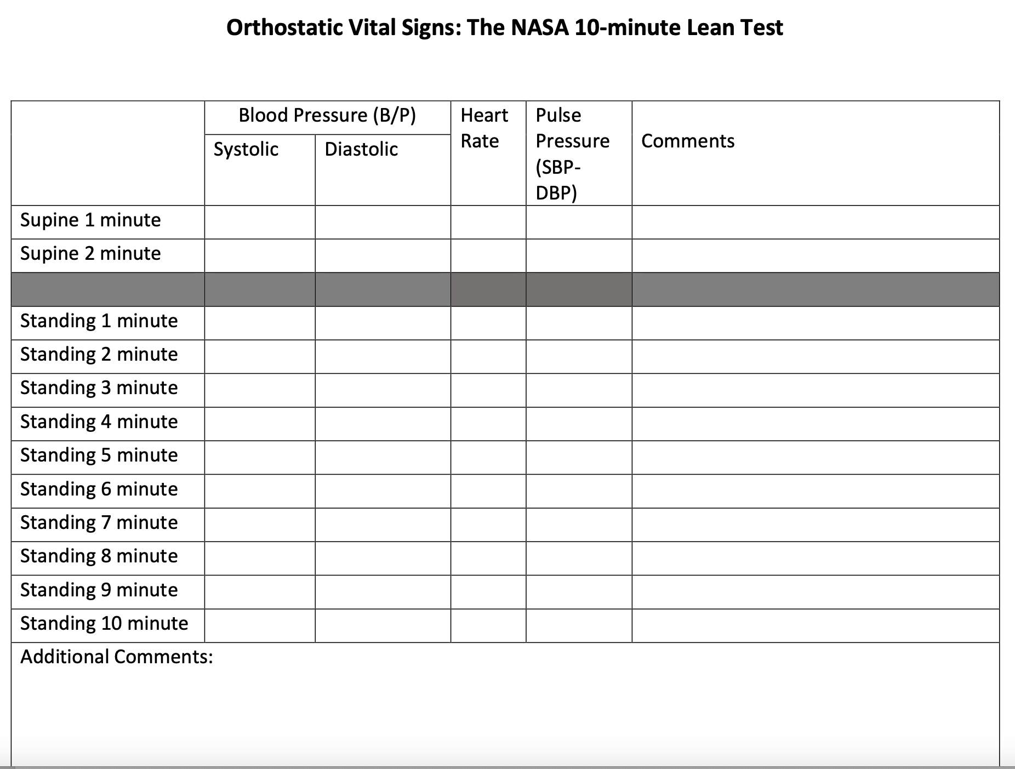
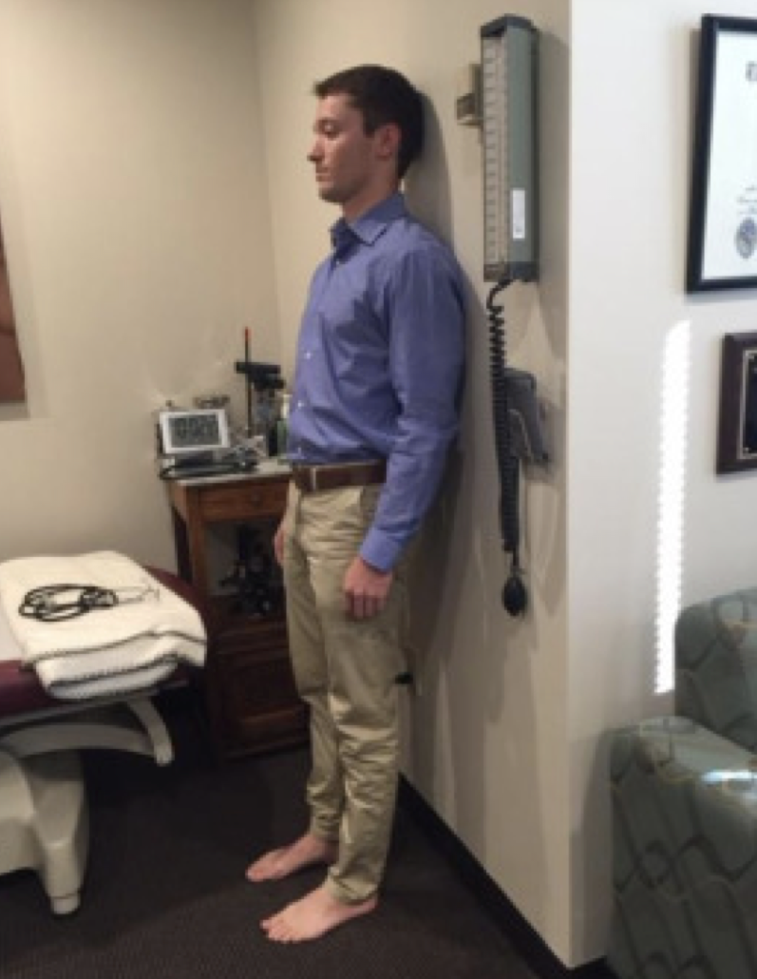
Instructions When Withholding Pharmacological and Behavioral Treatments
*All should be confirmed per provider and adjusted as appropriate*
Limit water/fluid intake to 1000 mL for 24 hours prior to test. The patient should not be dehydrated or overhydrated. If thirsty, they can drink water PRN.
Limit ADDITIONAL sodium intake for 48 hours before.
Do not wear compression socks or clothing.
Wear a short-sleeved shirt or tank top.
Withhold medications, supplements, and substances that might affect blood pressure or HR. Adjust timing according to drug half-life and patient safety.
Examples:
midodrine or Northera
fludrocortisone
beta blockers such as propranolol, metoprolol or atenolol
stimulants such as methylphenidate, dexadrine or caffeine
tricyclic antidepressants (TCA)-- amitriptyline, doxepin or cyclobenzaprine
Serotonin Norepinephrine Reuptake Inhibitors (SNRI) e.g. Cymbalta or duloxetine
tizanidine
https://batemanhornecenter.org/wp-content/uploads/2016/09/NASA-LeanTest-Instructions-April-2018.pdf

Slide 24
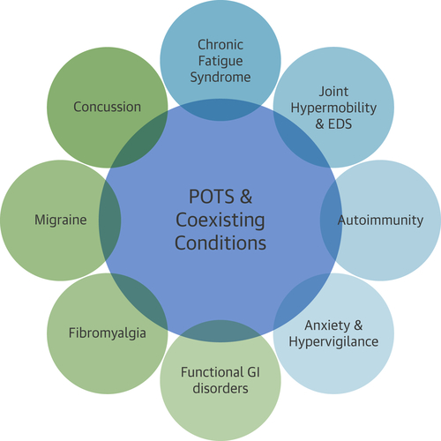
Postural Orthostatic Tachycardia Syndrome
Caution with labeling people post COVID with “POTS” and entering the “downward spiral” of decreasing activity, deconditioning and worsening symptoms.
HR and BP instability after COVID tend to improve and often resolve with time.
Meredith Bryarly et al. J Am Coll Cardiol 2019; 73:1207-1228.

Slide 25
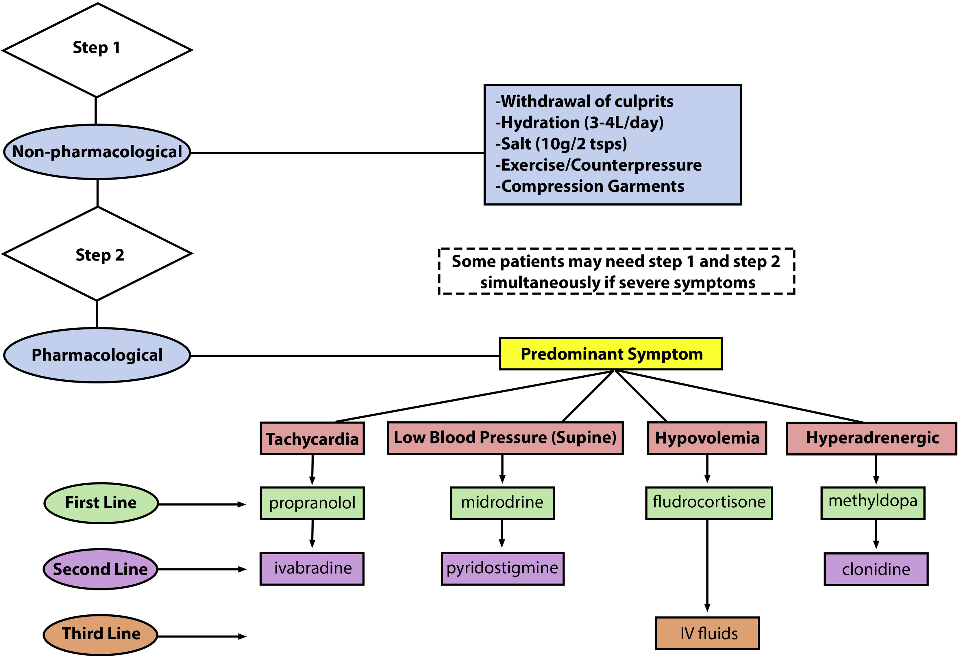
Orthostatic Tachycardia Treatment Algorithm
Canadian Journal of Cardiology 2020 36357-372)DOI: (10.1016/j.cjca.2019.12.024
Bateman Horne Center
Various resources for providers and patients
https://batemanhornecenter.org/providers/long-covid/

Slide 26
Mental Health (Anxiety, Depression)
Diet / Substances
Sleep
Tailored, Restorative Exercise
Specific management options
Activity and Exercise
Notes:
I am a PASC Clinician, Editor, Patient, Researcher

Slide 27
Treatments shown in clinical trials to be effective
Breathing exercises (McNarry MA 2022; Palau P 2022 – InsCOVID trial)
Tailored multicomponent exercise program (Jimeno-Almazán A 2022 RECOVE trial)
Pulmonary rehab (Vallier JM 2023 – in home or supervised)
Telerehabilitation self-management apps (Samper-Pardo M 2023 ReCOVery app: PE, health literacy, & self-efficacy, Philip KEJ 2023)

Slide 28
PEM and Exercise/Activity Recommendations
High intensity aerobic & graded exercise therapy can make symptoms WORSE.
Avoid overexertion, as this exacerbates ME/CFS and can hinder improvement
• Interval or time-based activity: The patient remains active only for the amount of time that doesn’t trigger symptoms, then rests, and then re-engages in being active for a similar interval, continuing in this way with a goal to increase the interval over time
• Wear a pedometer to monitor steps: Patients determine how many average daily steps they take over the course of a good week without flares or relapse and then keep their daily step counts in that range, with a goal to take at least 1000 steps daily to prevent deconditioning
• Monitor heart rate: Patients determine the maximum heart rate they can tolerate without triggering or exacerbating symptoms and then avoid exceeding that heart rate, except for short periods.
Often this is 120 or less (much lower than typical exercise programs that are 80% Max HR).

Slide 29
PASC Fatigue Treatment: The Four Ps Energy conservation
Pacing: Avoid the push and crash cycle common in post-COVID recovery.
Prioritizing: Focus and decide on which activities need to get done and which activities can be postponed to avoid overexertion and crashing.
Positioning: Modify activities to make them easier to perform.
Planning: Plan the day or week to avoid overexertion (energy windows).

Slide 30
Pacing
https://www.cdc.gov/me-cfs/

Slide 31
Specific management options
Medication Options:
SSRIs
LDN
Notes:
I am a PASC Clinician, Editor, Patient, Researcher

Slide 32
Role of SSRIs in preventing and treating long COVID
Reducing severity of acute COVID-19: 1 RCT of fluvoxamine in acute COVID. 100 mg bid x 10-14 days – reduced morbidity and mortality
(Lenze, JAMA, 2020 and TOGETHER trial, Lancet Global Health, 2021)
Mechanism: anti-inflammatory? Increasing serotonin levels?
Most potent Sigma 1 receptor (S1R) agonist among ten different antidepressants tested
(Ishima, Eur J Pharmacol, 2014)
? Preventing COVID-19: Risk of COVID-19 decreased among people taking antidepressants versus not in a psychiatric facility (OR) = 0.33, 95% CI 0.15-0.70, adjusted P < 0.05
Lower risk of infection and fluoxetine use (P = 0.023), as well as trazodone use (P = 0.001)
(Clelland, BJ Psych Open, 2021)

Slide 33
Naltrexone
Naltrexone hydrochloride: FDA approved 1984. Treatment of alcohol and opioid dependence
(50 mg tablet, 1-2/day).
Naltrexone/bupropion (Contrave): FDA approved 2014. Chronic weight management.
(8 mg/90mg, 1-4/day)
Low dose naltrexone: Widespread off-label use for many neuroinflammatory and other chronic inflammatory disorders, but especially chronic pain conditions.
“Ultra low dose” = microgram dosing
“Very low dose” = 0.1-0.5 mg daily
“Low dose” = 4.5-10 mg daily
“Moderate dose” = 10-25 mg daily
“High dose” = 50mg or more
WWW.LDNRESEARCHTRUST.ORG
LDN most commonly rx’d as 3-9 mg
Use of low-dose naltrexone in the management of chronic pain conditions: a systematic review. Hatfield E, Phillips K, Swidan S, et al. J Am Dent Assoc. 2020;151(12):891–902.e1. doi: 10.1016/j.adaj.2020.08.019. (chronic pelvic pain, complex regional pain syndrome, FM, and interstitial cystitis)
The use of low-dose naltrexone (LDN) as a novel anti-inflammatory treatment for chronic pain. Younger J, Parkitny L, McLain D. Clin Rheumatol. 2014 Apr;33(4):451-9. doi: 10.1007/s10067-014-2517-2. Epub 2014 Feb 15. Review.

Slide 34
Naltrexone
Naltrexone: an opioid receptor antagonist, metabolized in the liver (CYP450—none), excreted in urine, found in stool. T½ 4-5 hr (active metabolite 13-14 h).
A 50:50 racemic mixture of both levo and dextro isomers.
Low dose naltrexone behaves somewhat differently than high [full] dose.
Dextro-naltrexone acts as a Toll-Like Receptor antagonist. TLR-4 receptors are on microglial cells, other macrophages, and mast cells. Once activated, such cells produce inflammatory and excitatory factors that can cause sickness behaviors such as fatigue, pain sensitivity, sleep disruption, cognitive changes, mood disorders, and general malaise.
Levo-naltrexone is an opioid receptor antagonist, but more strongly at higher doses. LDN binds to receptors for 30-60 min. Blockade lasts 4-6 hours. Upregulates endogenous opioid production and opioid receptors. Increases endorphins favorable to the immune system.
Efficacy of Low-Dose Naltrexone and Predictors of Treatment Success or Discontinuation in Fibromyalgia and Other Chronic Pain Conditions: A Fourteen-Year, Enterprise-Wide Retrospective Analysis C. Noelle Driver and Ryan S. D’Souza* Biomedicines. 2023 Apr; 11(4): 1087. Published online 2023 Apr 3 . doi: 10.3390/biomedicines11041087.
Low-Dose Naltrexone for Chronic Pain: Update and Systemic Review. Kim P.S., Fishman M.A. Curr. Pain Headache Rep. 2020;24:64. doi: 10.1007/s11916-020-00898-0

Slide 35
LDN in a Long COVID cohort
Prospective single center interventional pre-post cohort study in Ireland
LDN 1 mg qd x 1 mo, increasing by 1 mg/mo, up to 3 mg
At 2-3 mo, improvement in 6 of 7 parameters measures (p <0.001): recovery from COVID-19, limitation in activities of daily living, energy levels, pain levels, levels of concentration, sleep disturbance, NO CHANGE in mood scores
52 Long COVID patients (40 female)
30% were HCW
Median age 43 (33-49)
Acute COVID: 27% admitted and 73% had outpatient management
Median length of illness 333 days (171-396)
38/52 actually took the LDN (73%)
2 stopped due to SE (GI, sleep, fatigue)
36 (69.2%) completed the 2-month questionnaire
Safety and efficacy of low dose naltrexone in a long covid cohort; an interventional pre-post study. O'Kelly B, Vidal L, McHugh T, et al. Brain Behav Immun Health. 2022 Oct;24:100485. Doi: 10.1016/j.bbih.2022.100485. Epub 2022 Jul 3. PMID: 35814187 Free PMC article

Slide 36
Ongoing RCT of LDN for Post-COVID Fatigue
Double-blind, randomized, placebo-controlled trial.
Study duration: 16 weeks. Dose increasing weekly from 1 mg, 2 mg, 3 mg, to 4.5 mg
N=160 Male and female. 18-70 years. Acute COVID-19 in 3-6 months prior
Primary outcome: Change in the Fatigue Severity Scale (FSS)
Secondary outcomes (partial list):
Pain Severity VAS
Symptom severity PQSymp-12
Average steps/day, maximum hand grip, sit and stand test
Self reported Qualify of Life. EuroQol-5
Exploratory outcomes: Cytokines, CK, reverse T3, cortisol, ACTH, POTS/OH, sleep, depression, anxiety
Enrollment 5/2023 and study end 5/2024
Principal Investigator: Luis Nacul, MD, PhD, BC Women's Hospital + Health Centre/ Univ of British Columbia

Slide 37
LDN challenges and barriers
Naltrexone is generic. Little financial gain for prominent U.S. pharmaceutical companies to fund Phase III trials
Naltrexone 50 mg tabs are affordable because insurance will pay.
Compounded LOW DOSE naltrexone can be more expensive because insurance often won’t cover compounded drugs.
LDN can be found for $25-30/mo online (some pharmacies charge up to $130/mo).
Naltrexone is stable dissolved in distilled water and refrigerated for up to 2-3 weeks.
Mix a 50 mg naltrexone tablet in 50 ml of distilled water to make a 1 mg/ml solution
NPR Article about low dose naltrexone: Https://www.npr.org/sections/health-shots/2019/09/23/741783834/in-tiny-doses-an-addiction-medication-moonlights-as-a-treatment-for-chronic-pain Https://www.practicalpainmanagement.com/treatments/pharmacological/non-opioids/use-low-dose-naltrexone-management-chronic-pain

Slide 38
Things I’ve learned about treating patients with Long COVID
No two people have the same symptoms or same course
There is no single treatment for long COVID….yet
We do have many effective treatment strategies already – patients are getting better.
There is hope!
COVID-19 lights everything on fire – there are many associated psychosocial stressors and consequences of COVID
Patients feel relieved when they find a doctor who understands long COVID – but access to long COVID specialty clinics is poor and support for multidisciplinary clinics is inadequate to manage the high volume of cases.

Slide 39
9 grants awarded ($5 million over 5 years) to support existing multidisciplinary Long COVID clinics across the country to expand access to comprehensive, coordinated, and person-centered care for people with Long COVID, particularly underserved, rural, vulnerable, and minority populations that are disproportionately impacted by the effects of Long COVID.

Slide 40
AHRQ Long COVID GRANT: UW Investigative Team
Janna Friedly MD, MPH (co-PI), Rehabilitation Medicine
Jessica Bender, MD, MPH (co-PI), General Internal Medicine
Nikki Gentile, MD, PhD (Co-PI), Family Medicine
Leo Morales, MD, MPH (Co-I ), General Internal Medicine
Anita Chopra, MD (Co-I), General Internal Medicine
Julie Hodapp, MD (Co-I), Rehabilitation Medicine
Payal Patel, MD (Co-I), Neurology
Rachel Geyer, MPH (Co-I), Family Medicine
Lindsey Knowles, PhD (Co-I), Rehabilitation Medicine
Tracy Herring, PhD (Co-I), Rehabilitation Medicine

Slide 41
Other forums for dissemination:
Project ECHO
Popular websites
Press releases
Media events
batemanhornecenter.org

Slide 42
Additional Opportunity to Get Involved
Long COVID/Post COVID Interest Group at the WA ACP
sharing management tools
offering case discussions/provider education
exchanging experiences from our clinical practices
Why should I sign up?
How do I sign up?
achoprag@uw.edu
Sign up sheet at the ACP table

Slide 43
UW Post COVID Rehabilitation and Recovery Clinic at Harborview Medical Center
Contact information:
Janna Friedly, MD, MPH
friedlyj@uw.edu

